Slide 1
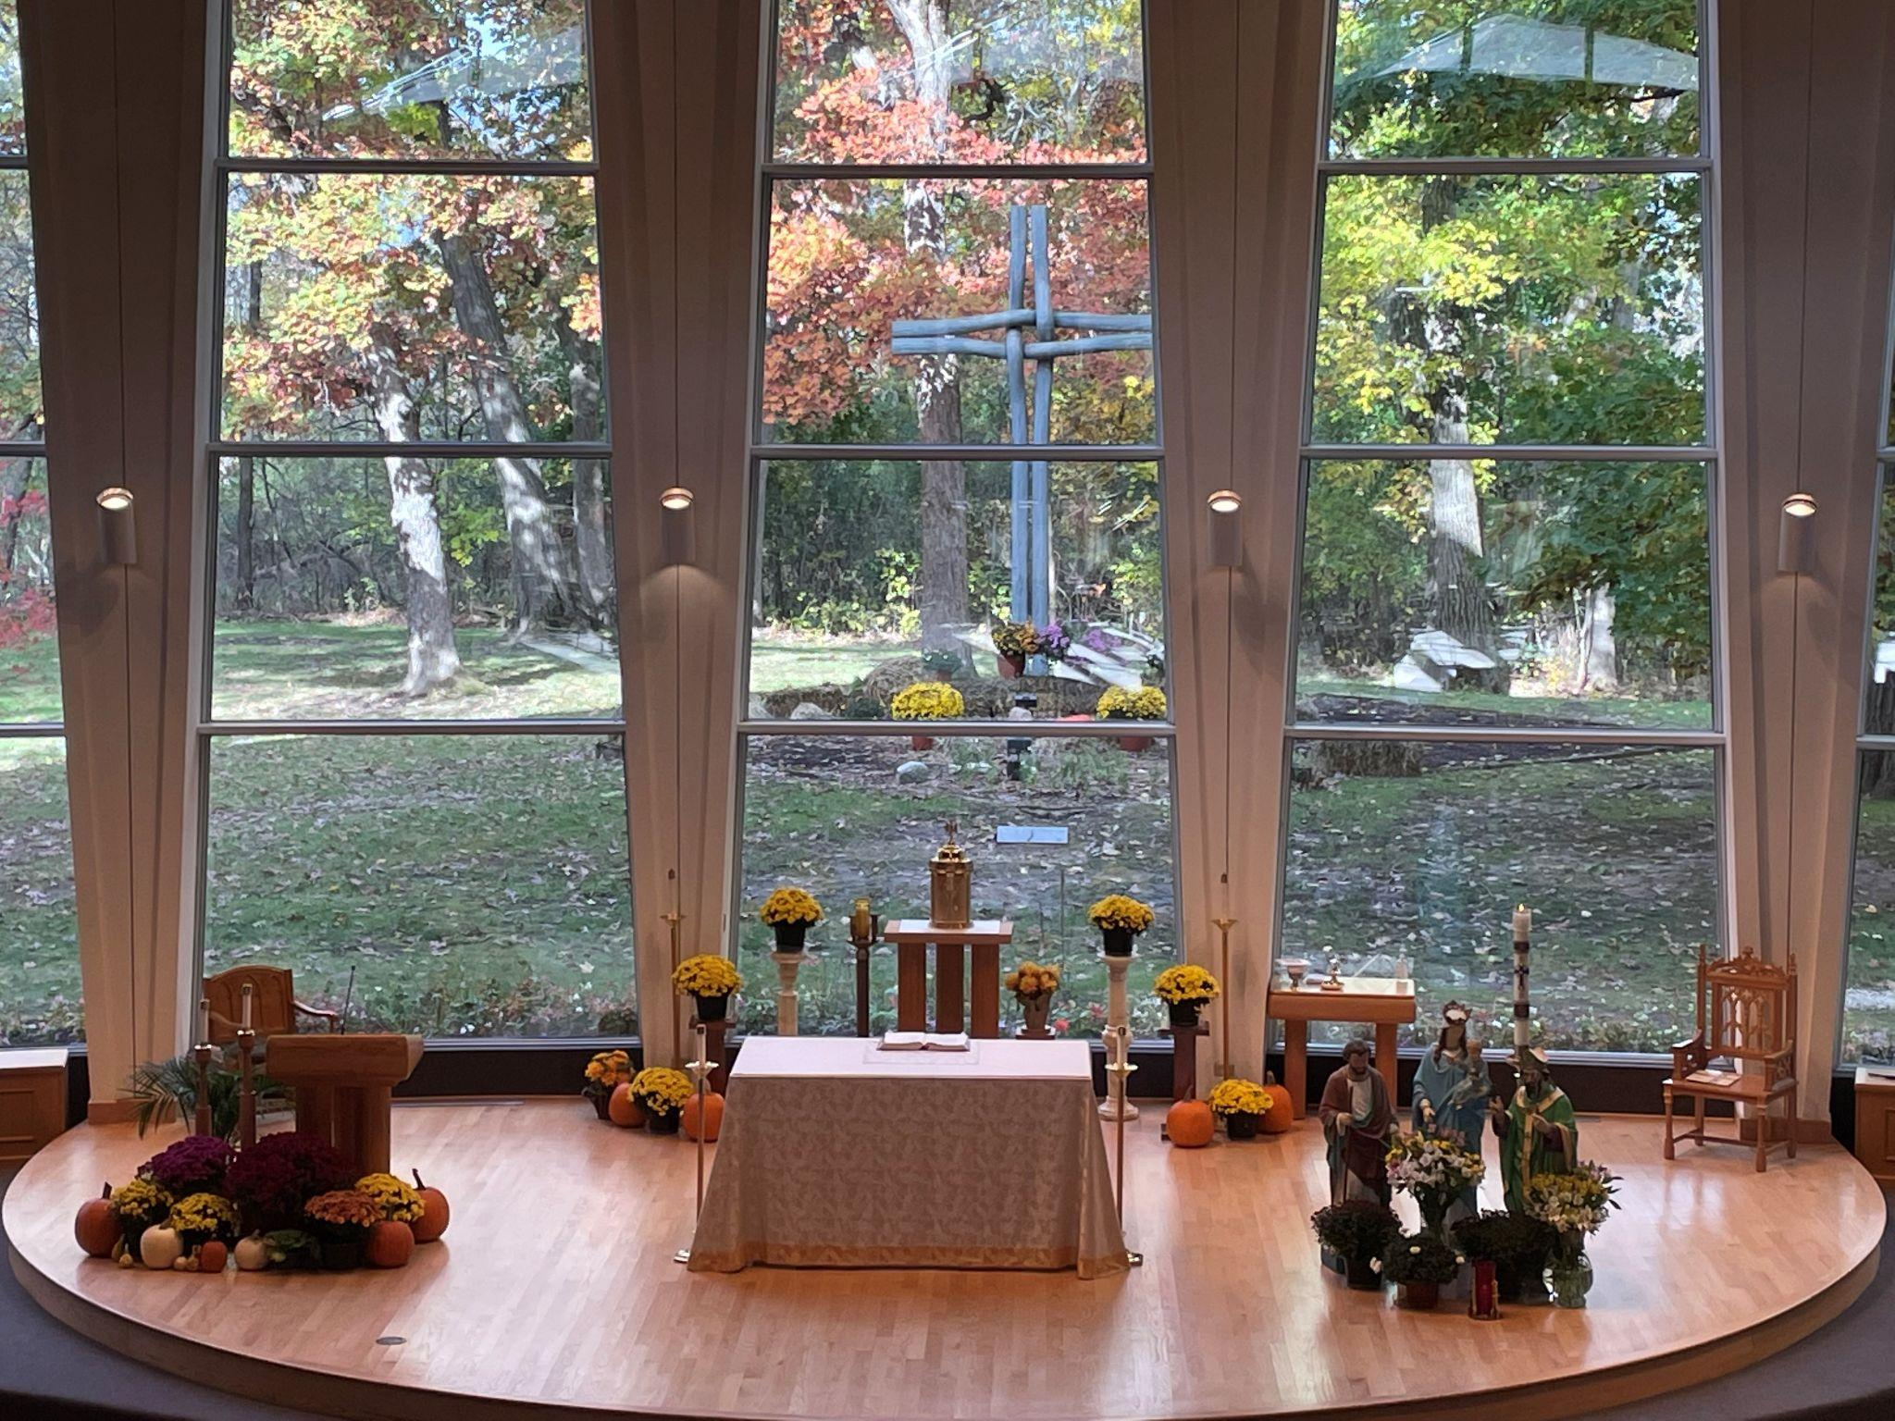


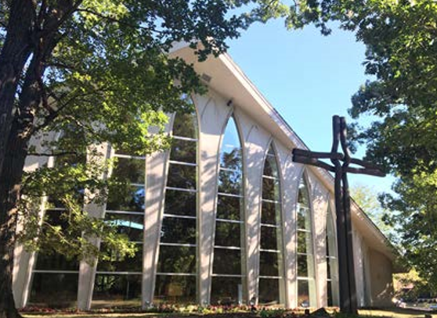
Laudato Si'
St. Patrick’s Church
“As a faith community, we are the hands and feet of Christ, reaching out as He did.”

Slide 2
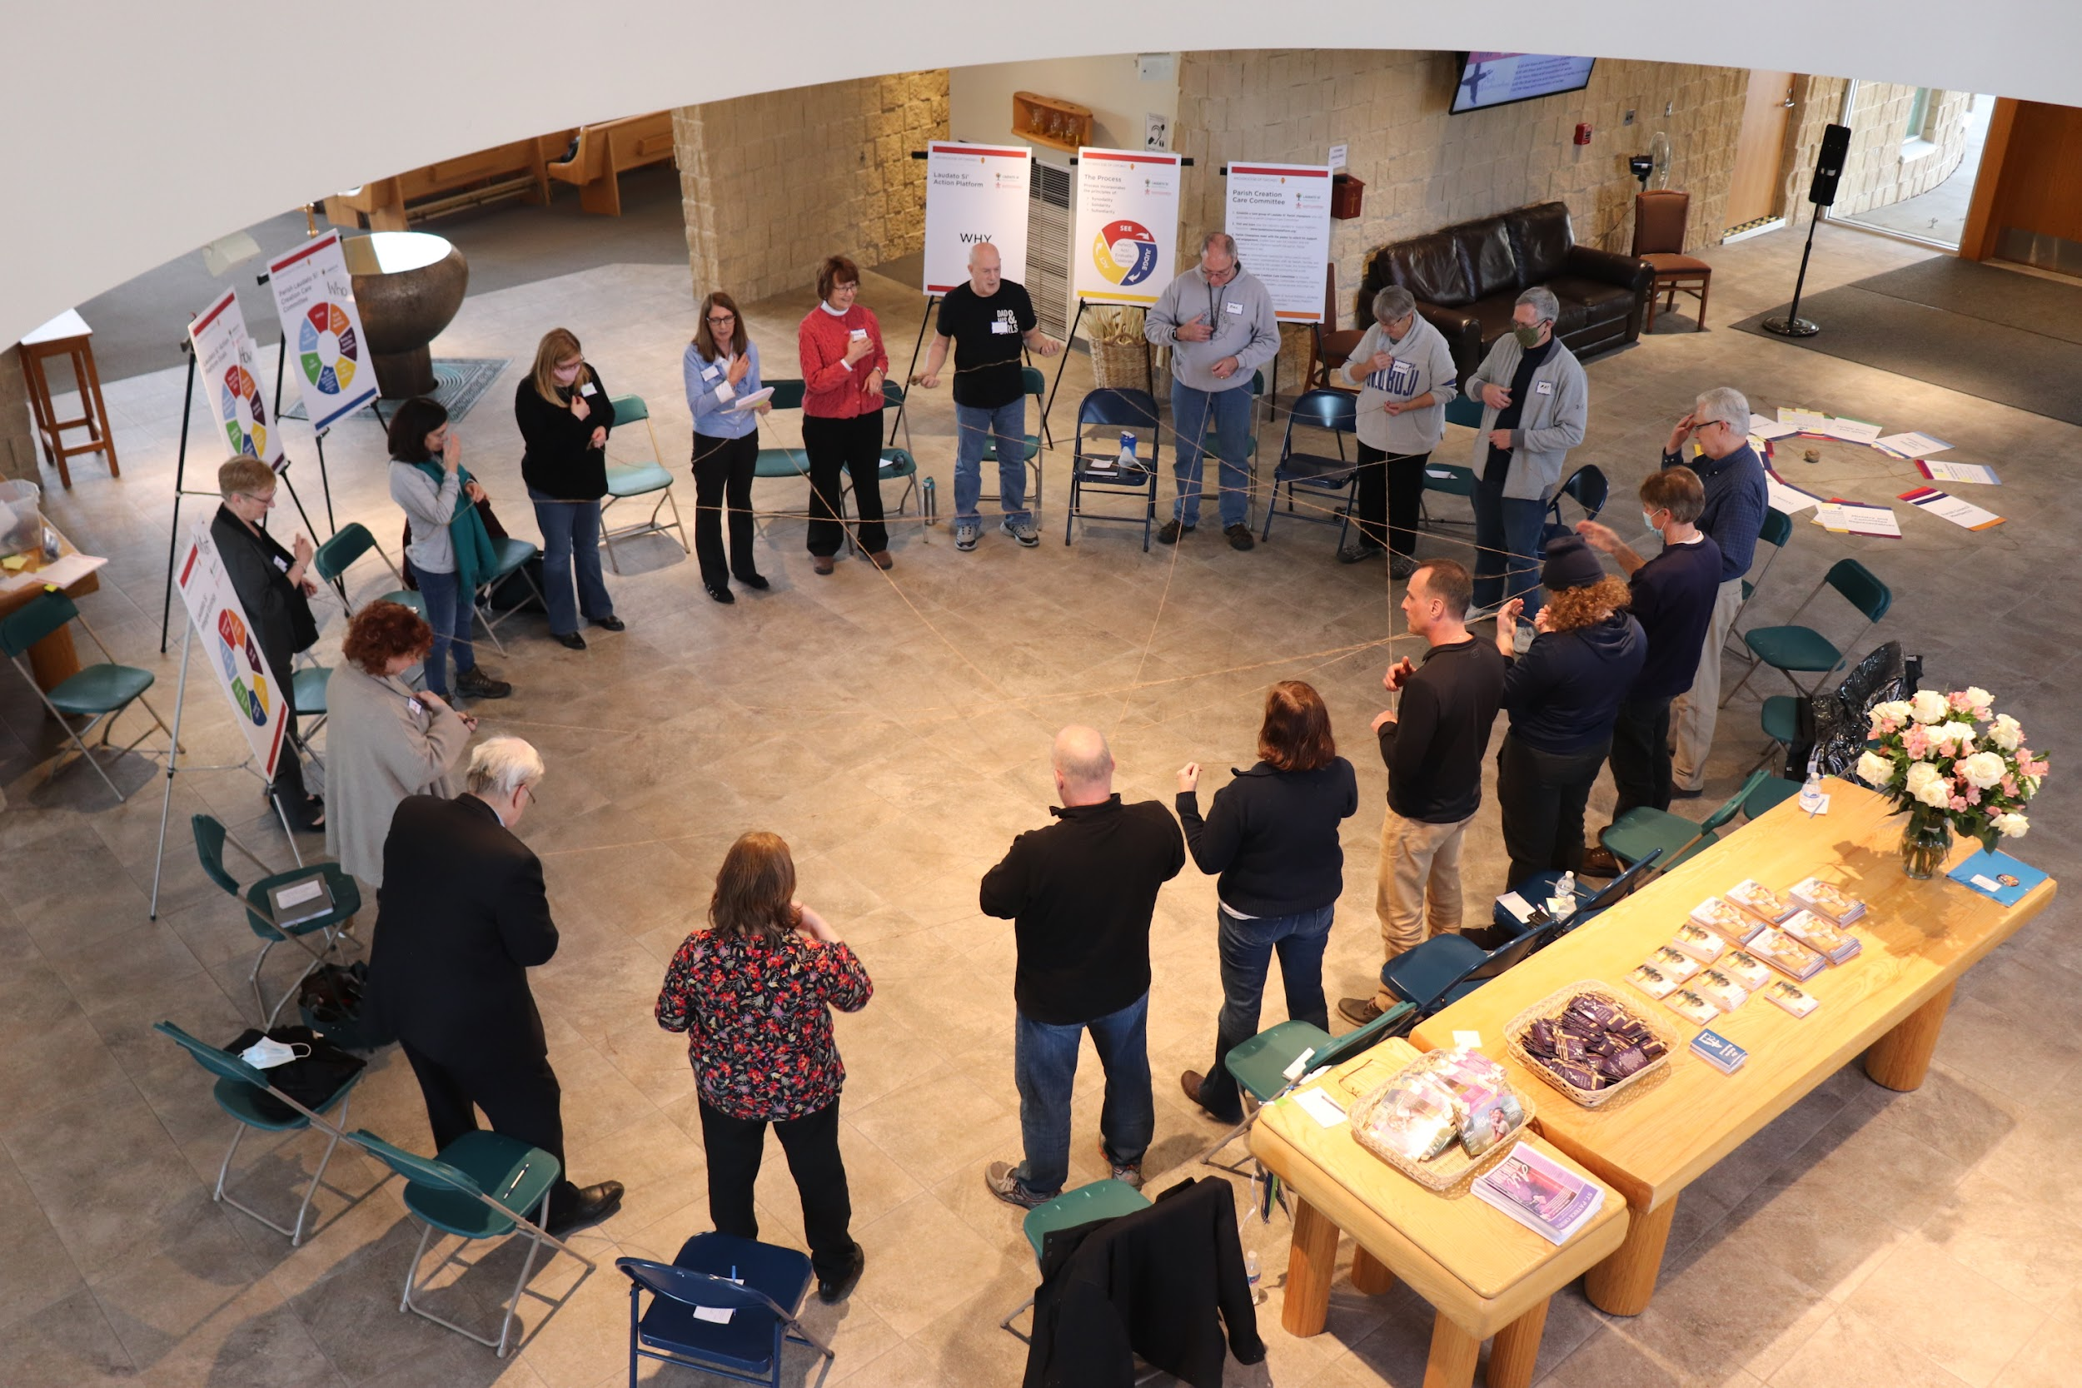
The Beginning of St. Patrick’s Laudato Si' Journey
St. Patrick officially kicked off our Laudato Si' journey in February 2022 with a workshop to educate the audience on all things Laudato Si' We spent an afternoon in the church narthex learning about the seven Laudato Si' goals, how they are all interconnected and how each of us must take action, however small, to start the needed change to becomes stewards of creation.
We then formed the Creation Care Committee, which began its journey by reading and discussing the six chapters of Pope Francis’ Encyclical. The committee began socializing Laudato Si' messages in the bulletin and on the website to engage parishioners. Physical improvements in the parish office were made to replace ballast lighting with LED and add recycling. The replacement of ballast lighting with LED in the parish school is also now complete. Various projects to improve the natural gardens on our premises are underway.

Slide 3
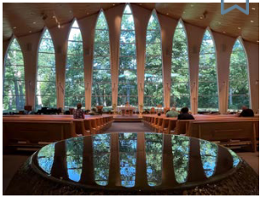
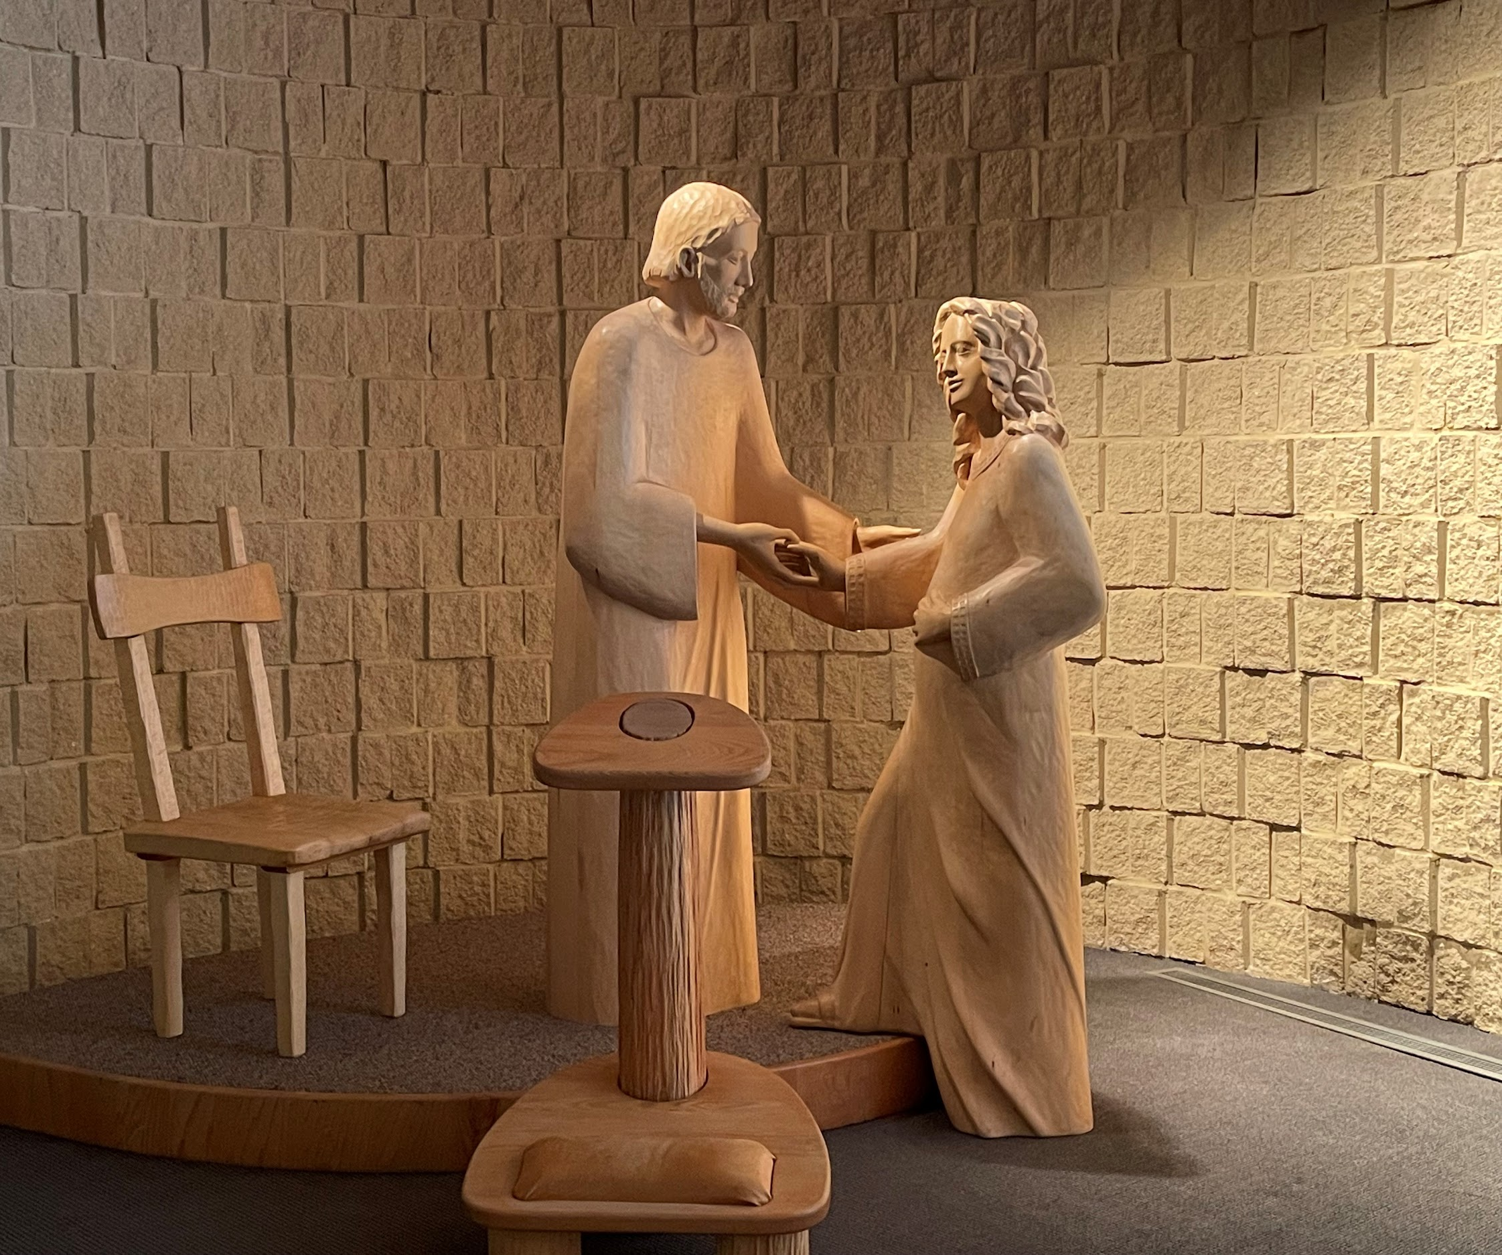
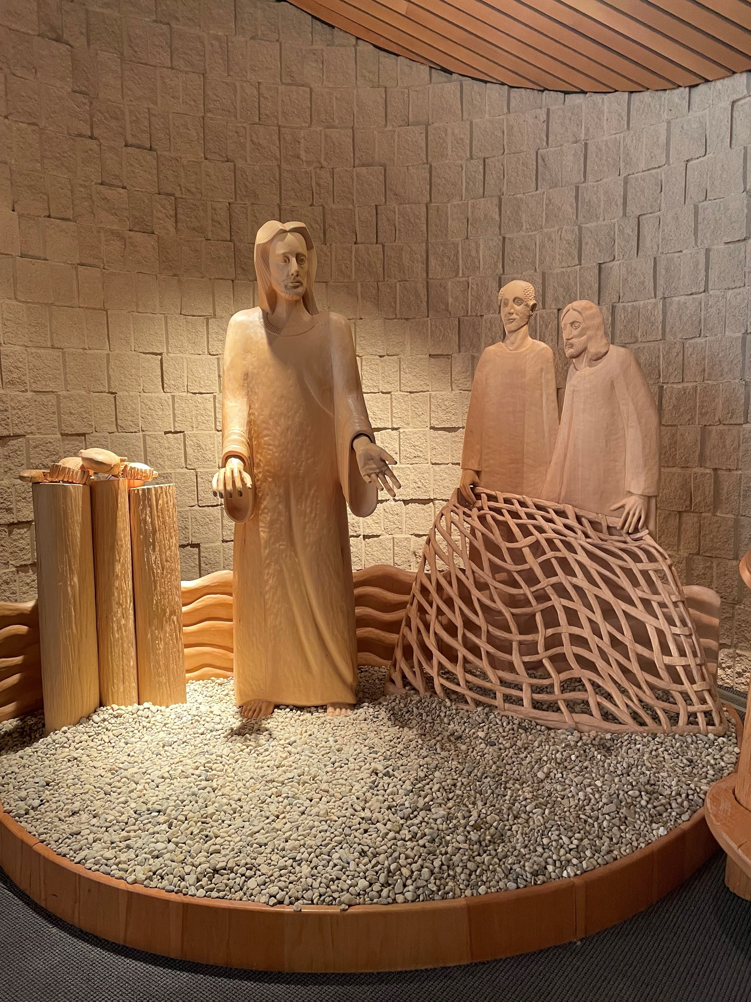
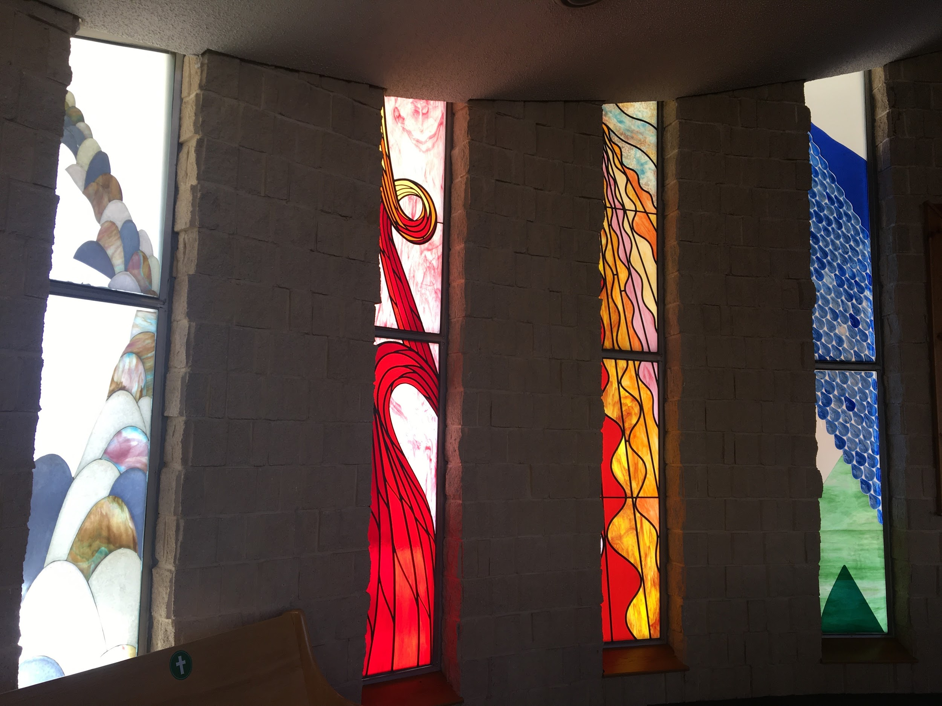
A Legacy of Connecting with Creation
St. Patrick Church of Wadsworth, Illinois has a long and vibrant history of supporting the care of creation and the care of the poor. Originally founded in 1849 as a frontier mission on the Illinois/Wisconsin border, the tiny church was established to serve the needs of a wide-spread farming community. By 1978, the parish of about 300 families started to feel the effects of “urban sprawl”, and grew to 2000 families by 1995, which is the approximate size today.
When a new worship site was built in 1991, the mandate from the people was to “Maintain the sense of intimacy of the old church, save as many trees as possible and to somehow ‘bring the outside in.”
This now 30-year old worship space has an all-glass sanctuary wall that looks out on a natural woodland with a variety of old-growth trees. The interior features a baptismal font with flowing water, and two life-sized sculpture scenes made of wood. The first depicts a compassionate Joseph welcoming a young pregnant Mary into his home, capturing the difficulties that constantly appear in our lives. The second scene is of the risen Christ standing on a sandy seashore next to the fish he has prepared for the incredulous and hungry disciples next to him with their empty nets. Again, the natural environment, and compassionate care for others is literally built into our physical church.
Ways we connect to Creation:
Outdoor stations of the cross
Firepit
Memorial Garden
Outdoor Cross
Outdoor Mass
Ecological Spirituality
Response to the Cry of the Earth

Slide 4
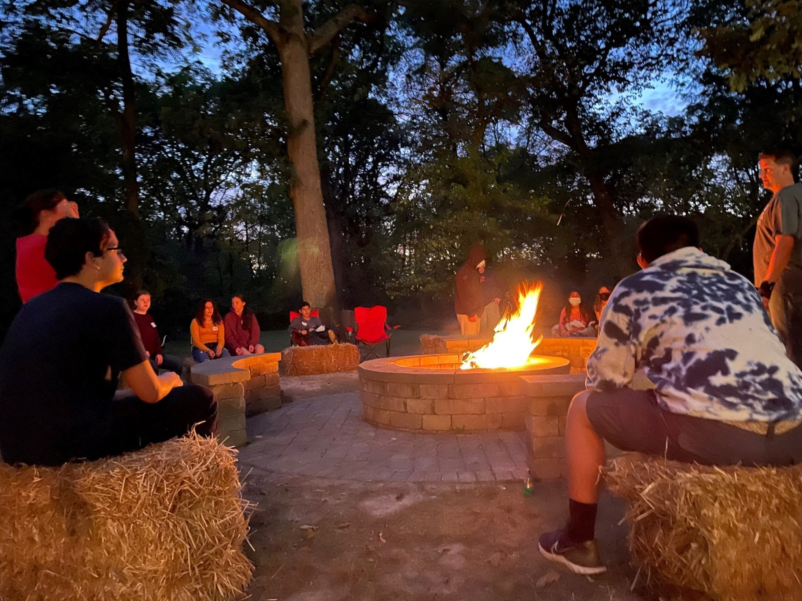
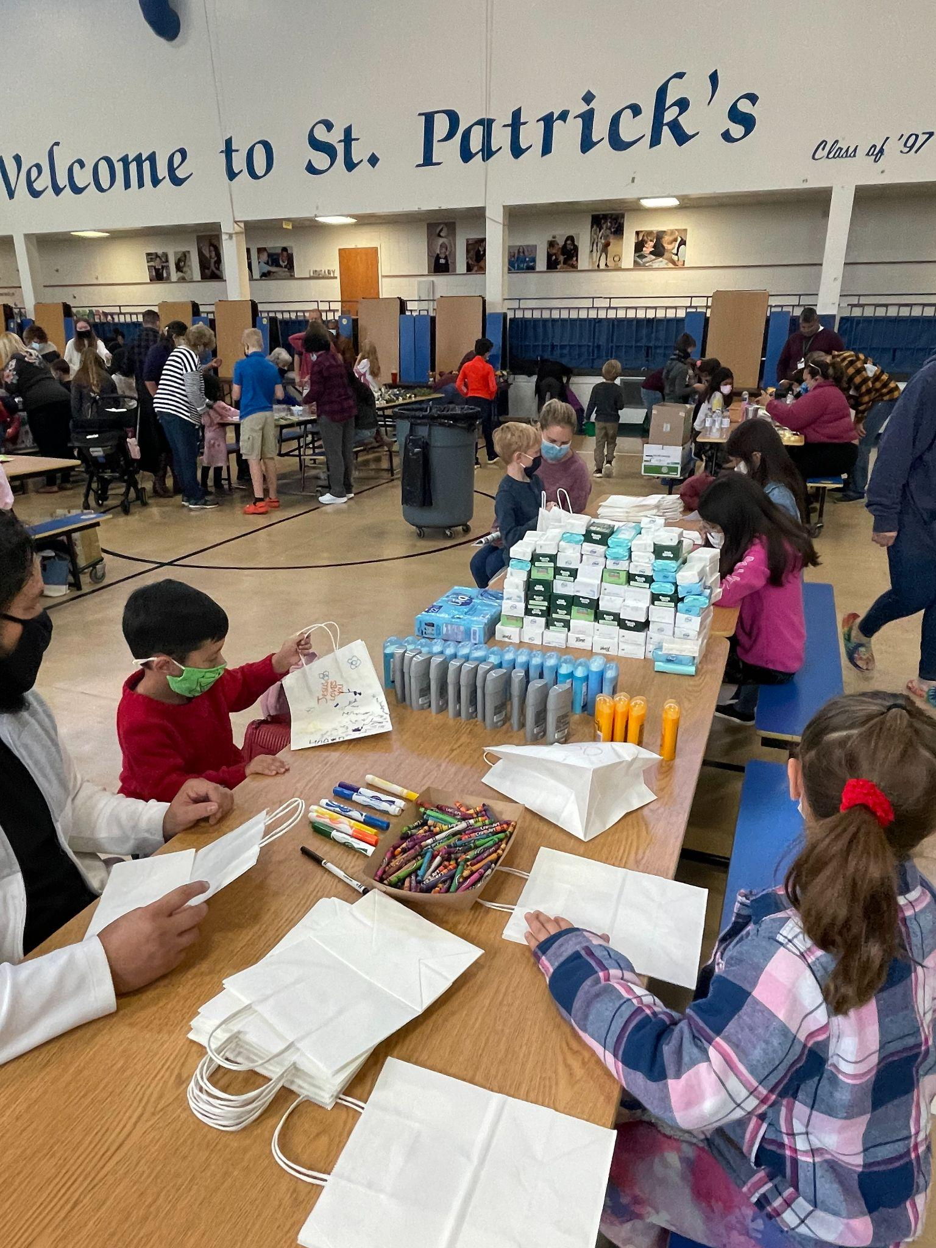
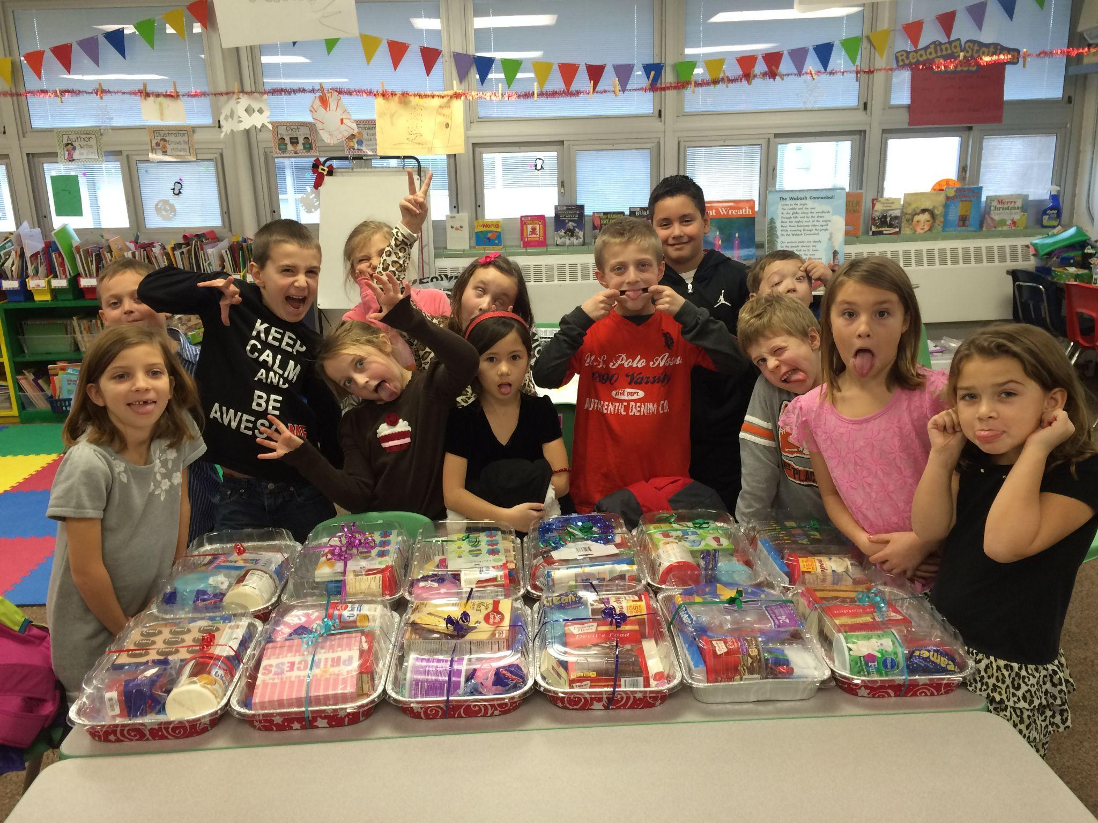
Education is the critical first step in Laudato Si'
St. Patrick School was founded in 1956 and soon after had enough capacity for two classrooms per grade from kindergarten through eighth grade. The school has educated more than 25,000 students and currently serves ~400 students per year from preschool through eighth grade.
The SRE program began serving children outside Catholic schools in the early 1900s and has continued ever since.
The school/religious ed. children have long participated in projects that support the local community and the environment.
The Creation Care Committee has started publishing educational pieces and tips in the bulletin and monthly newsletter. In addition, we’ve created a page on the parish website that provides updates on activities and links to useful information that supports Laudato Si'
We recognize that creating awareness in the first step in taking better care of God’s creation. In particular, as our parish community is growing older, we need to engage not only the current active members, but also the younger members of the parish to ensure the vitality of the parish continues. We have begun engaging high school and college age parishioners in Laudato Si'.
Ways we educate:
Parish School
SRE (School of Religious Education)
Laudato Si' Specific Efforts:
Added page on parish website for Creation Care to share events and links to valuable information
Articles in weekly bulletin and monthly parish newsletter to educate parishioners on Laudato Si'
Ecological Education

Slide 5
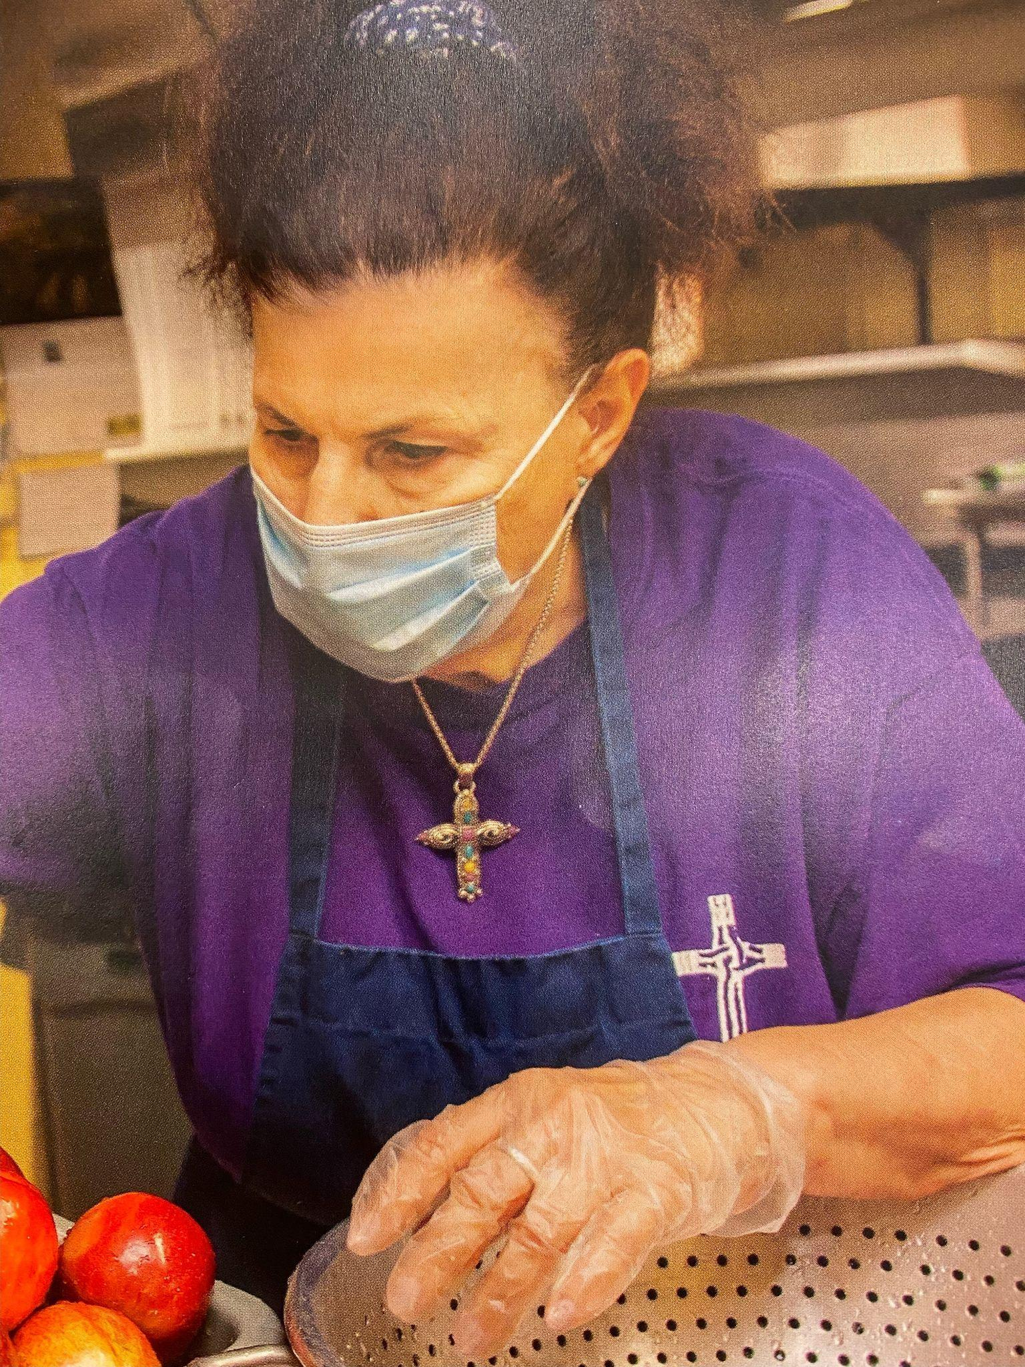
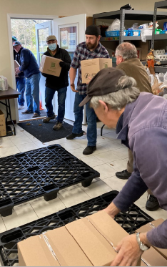
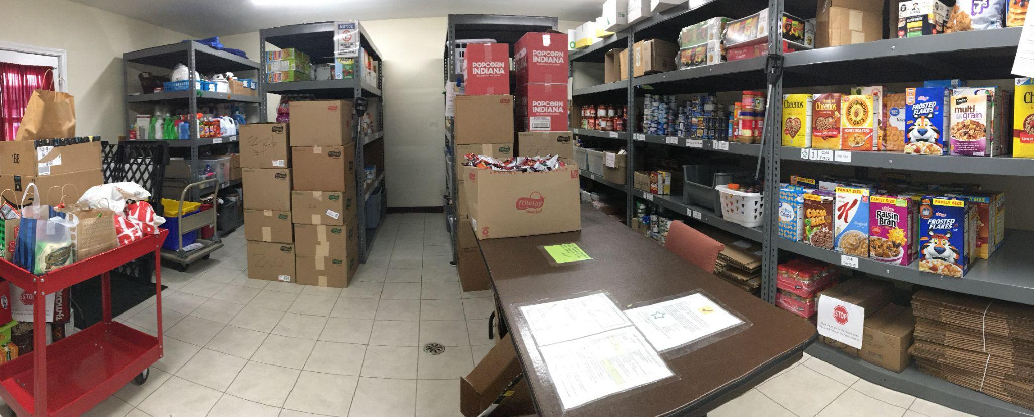
Local Outreach Programs are at the heart of St. Patrick Ministries
St. Patrick Parish has long-standing local outreach ministries as well as many others that arise out of immediate needs and are taken on by the church or school. They are a mainstay of parish ministries, and the school teaches that “Service to Others is at the Cornerstone of our Faith”. The principal’s monthly newsletters feature the many service projects led by and through the classrooms. The Food Pantry started as a small collection inside the church office and expanded to the entire garage area, currently serving ~50 families/month with healthy meals. St. Patrick’s has been responsible for Wednesday service at a local soup kitchen for many years. Volunteers prepare and serve food, (up to 175 meals are given out some weeks) and collect and give away home goods and clothes.
Parishioners also generously participate in numerous efforts each year to provide money, food, diapers, coats and gifts to local organizations that are provided to homeless and others in need.
What we do:
Food Pantry
Soup Kitchen
Good Samaritan Fund
Catholic Charities Gift Drive
Basket Ministry
Diaper & Baby Bottle Drive
Response to the Cry of the Poor

Slide 6
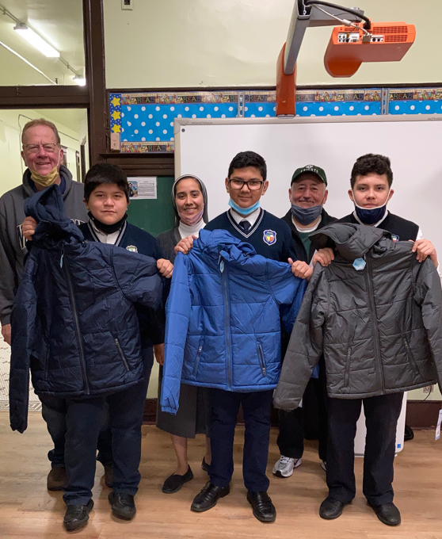
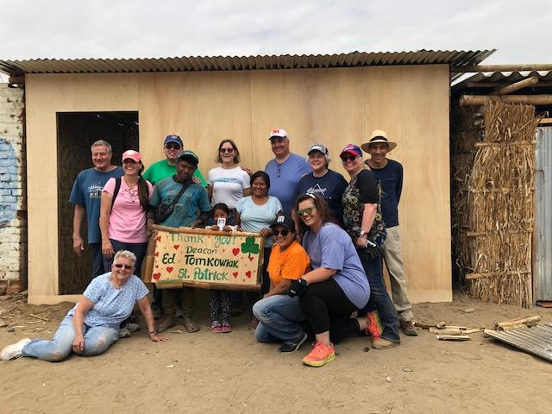
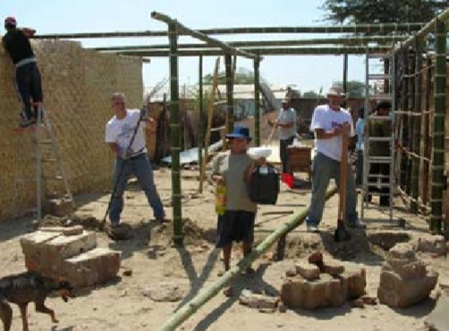
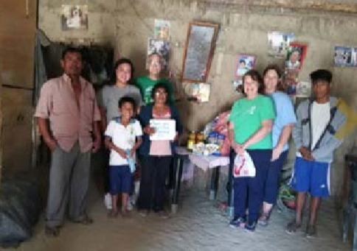
St. Patrick Outreach goes beyond our Local Community
Our parish recognizes that we are in a position to assist others in need outside our local community. Ministries have been established for many years.
We have a Sharing Parish in the Chicago Archdiocese for which we provide financial assistance, Christmas gifts and prayers.
We also have a contingent of parishioners who are involved in supporting the Santisimo Sacramento Parish in Piura, Peru. Annual mission trips to build homes and connect with families have occurred since 2002. A Family-to-Family program also allows our parishioners to sponsor families in that parish. Many of our families have met their sponsor families through the mission trips.
An example of student outreach is a 2020 school project in which the 7th grade class read the memoir “A Long Walk to Water” and researched the global water crisis. They were inspired to start a “Socks for W.A.S.H.” (water and sanitation hygiene education) campaign through the nonprofit H20 FOR LIFE. In spite of the pandemic, they raised $625 for the Ssango Primary School in Uganda, providing them clean water and sanitation.
Response to the Cry of the Poor
What we do:
Sharing Parish
Coats for Kids
Peru Annual Mission Trip
Peru Family-to-Family Ministry

Slide 7

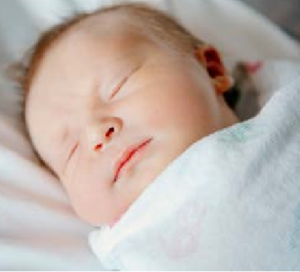
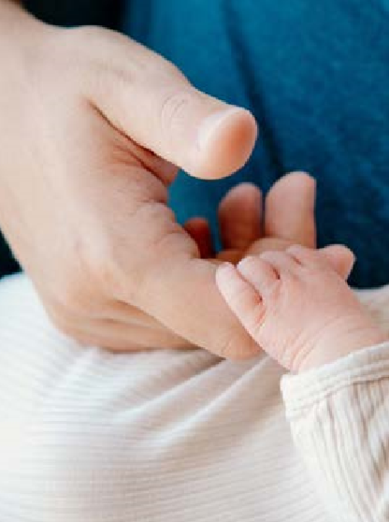
Today and the Future of our Parish with Laudato Si'
Although there are still a few private farms in the area, we are now a well-established suburban community with many conveniences, but still a small-town feel. While many of those who helped create this parish are still around and active, it is now their children and grandchildren, as well as those moving to this area who are fueling the energy and life into our community today. We now have a unique opportunity to introduce parish teens, young adults, and growing families to a renewed style of ministry that is emergent from the principles of Laudato Si'
In this Summer 2022, the parishes of St. Patrick and Our Lady of Humility, located about 4 miles down the road, are uniting into one parish under a new pastor. The two churches have ministries in common, but we also recognize the uniqueness of each community and the inherent diversity that will serve to enhance and better embody the principles of Laudato Si' and our interconnectedness. Our church names, for example, lead us to consider and represent the humility of our Blessed Mother and the missionary zeal of St. Patrick.
Over the coming months, the two church communities will come to know more about each other and how we can best unite into one diverse and thriving parish. This will include a re-assessment of the parish as a whole and additional or revised items that we intend to incorporate into future Action Plans going forward.
In addition to continuing the existing ministries at the parish, we want to focus next on the spirit of these Laudato Si' goals:
Ecological Education
Ecological Spirituality
Adoption of Sustainable Lifestyles

