Slide 1

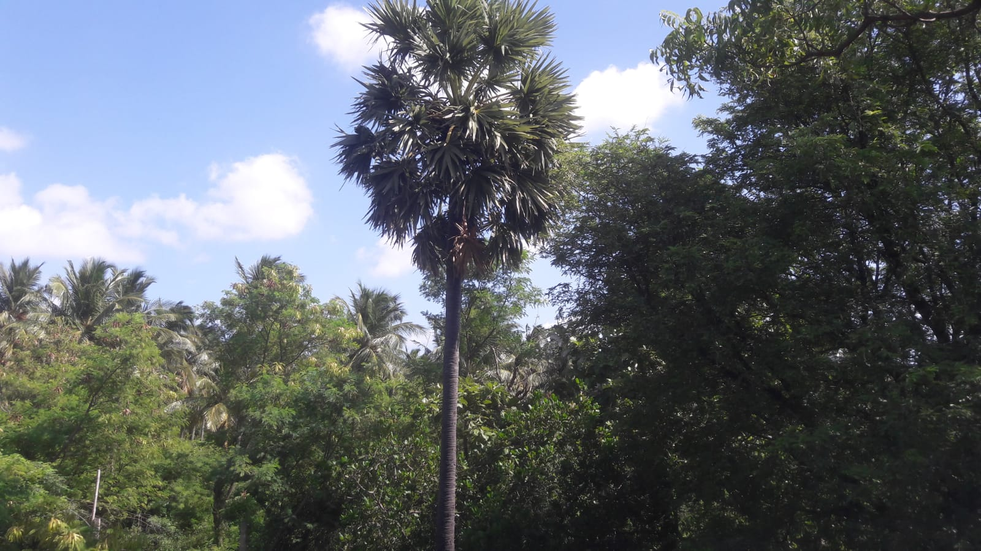
Transition towards Laudato Action program in Claretian life and Mission

Slide 2

Introduction to LS
SDGs Published in 2015: Agenda for Development
LS Published on 24.05.2015: Ethical Agenda for Development
Pope Francis:
On 5th Anniversary of LS, 2020 given urgent call to attend the Ecological Crisis;
The earth herself is burdened and laid waste (LS 2).
This ecological destruction summons for an urgent and profound interior conversion (LS217
Vatican: The Care for Creation section of the Dicastery for Promoting Integral Human Development (DPIHD) and Laudato Si Movement (LSM) has organized Laudato Si’ Roll-Out Plan for 2020 and Beyond. With 7 LSG: Cry of the Earth, Cry of the Poor, Ecological Economics, Sustainable Lifestyle, Ecological Education, Ecological Spirituality and Advocacy and campaign. For 7 Sectors: Catholic Families, Parishes, Dioceses, Schools, Universities, Businesses/Farms/Hospitals, Religious Congregations and other Institutes of Consecrated Life

Slide 3

Environment and the Poor are in great danger
Madras, India, High Court Judgement on 13.09.2021:
Protest against a Copper smelting plant and killing of 16 protestors by the Police Thoothukudi, Tamil Nadu, India.
The copper smelter plant was started 1996. But people’s protest began from 1993 onwards.
It apart from smelting copper produced phosphoric sulphuric acids. The solid and liquid wastes from the plant was discharged into the surrounding areas . In January 2018 the copper plant doubled its capacity . The people living around the plant were concerned about the further deterioration of the environment and their health. So they started intensive but peaceful protests. The protest spread to various places of the region. The people undertook 100 days sit in protest. On the 100th day (22.06.2018) 50,000 people went in procession to give petition to the govt. The police fired on the peaceful protestors in which 16 were killed and several wounded.

Slide 4

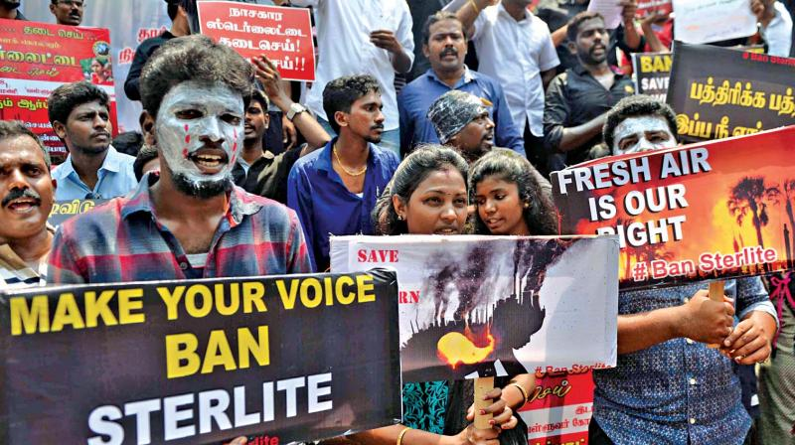
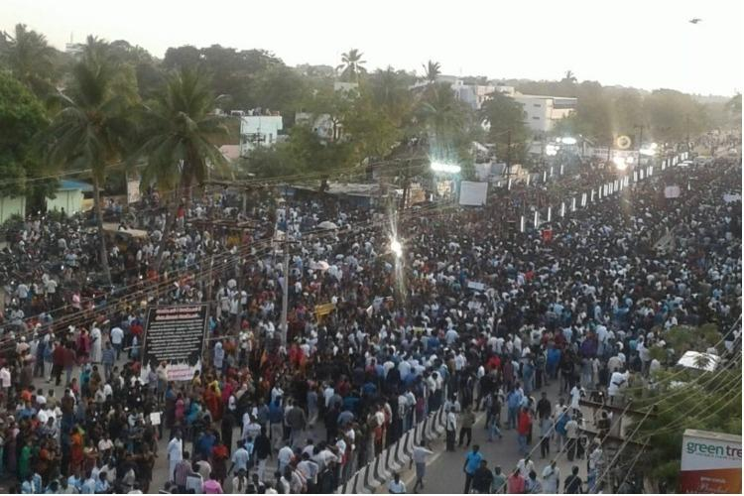

Slide 5

The National Human Right Commission(NHRC) came forward by itself to investigate event. The NHRC collaborating with the copper plant and government closed the enquiry on 25.10.2018 . A HR defender Mr. Henry filed a case asking to reopen the enquiry.
Hearing his petition the Madras High Court, India has said on 13.9.2021, “ The shooting incident is a scar on the face of our democracy. If there can be something that can be done for families… there has to be closure of the plant”.
What are the connections between LSGs and this incident? We can share…

Slide 6
The care for the environment and the Poor is an age old mission of the Claretians and the Church.
1. Alternative therapy
2. Ashram and other Activities
Mission of the Claretian Province of Chennai.

Slide 7

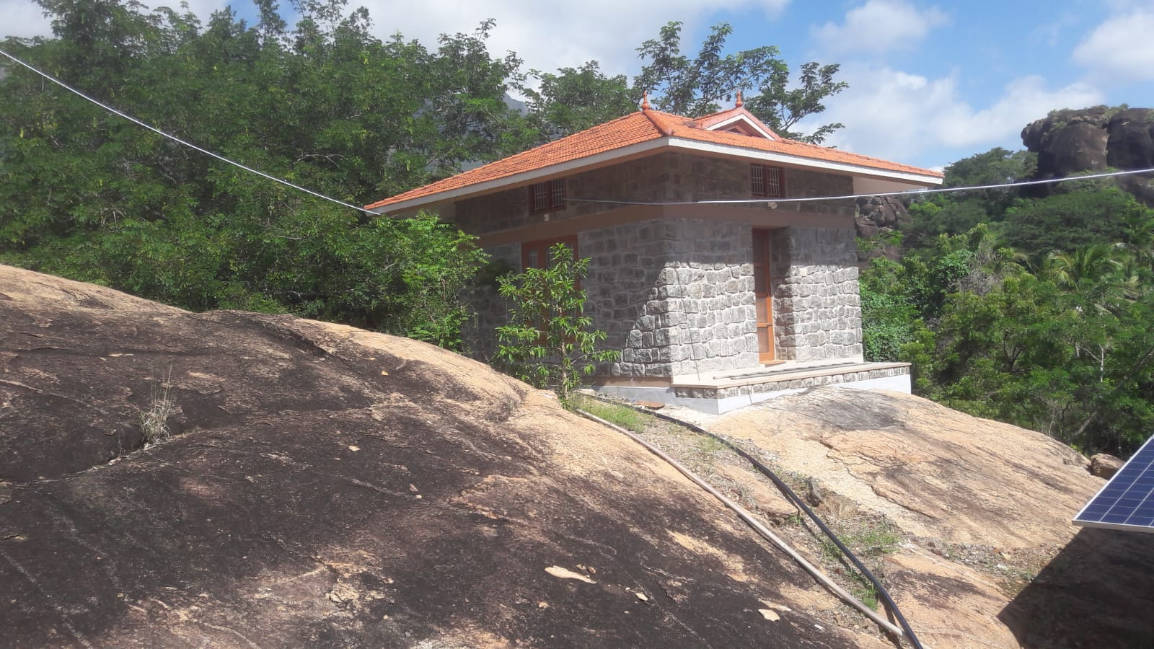
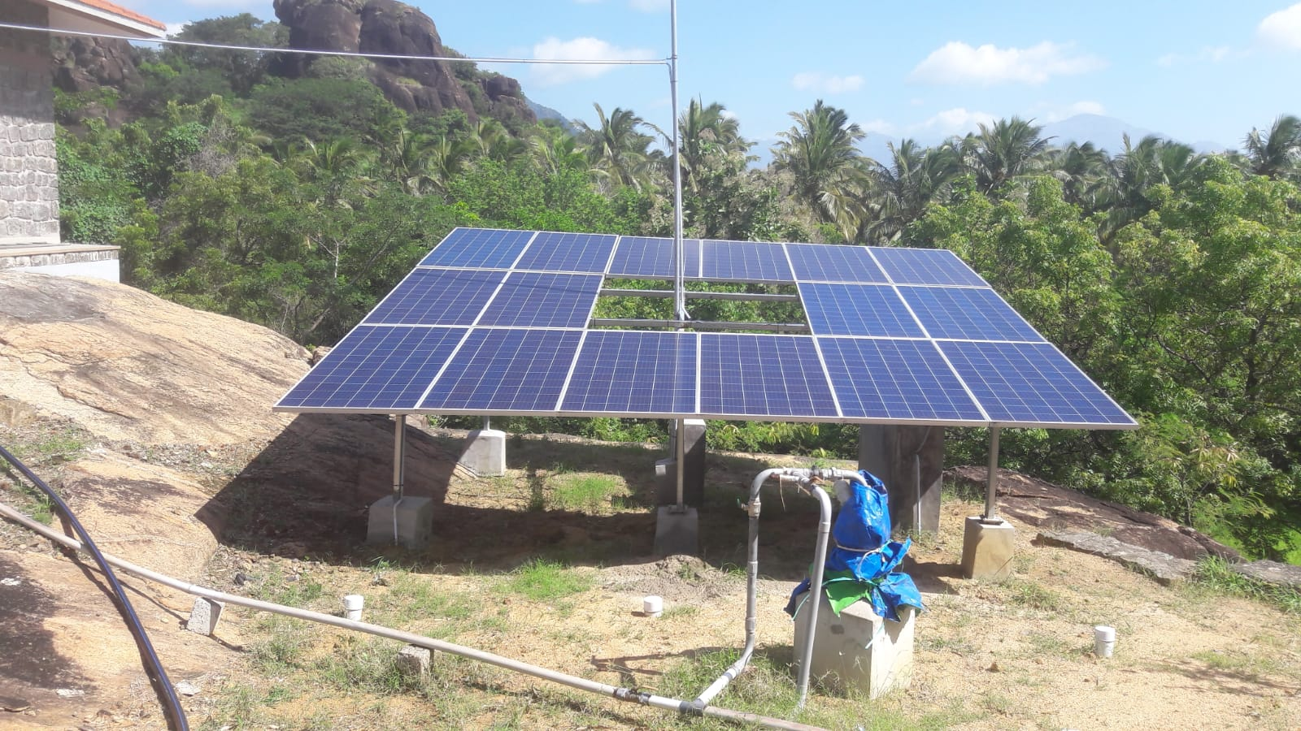
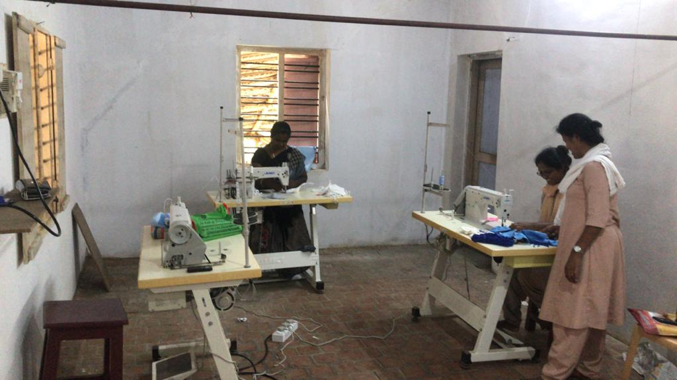
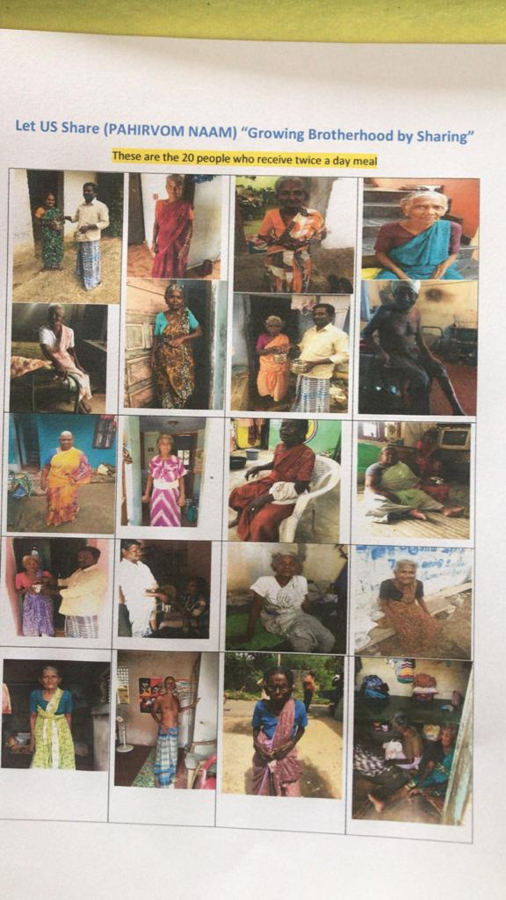
Claret Amaidhyagam ( Claret Peace Centre)Promoting integral ecology

Slide 8
GOD, ENVIRONMENT AND POOR AS COMPONENTS OF MISSION INTEGRAL ECOLOGY
Promotes alternative health systems.
Claret Peace Centre is located in Tamil Nadu, India. It is an Ashram( Centre of Integral Spirituality)
It promotes Contemplative spirituality
It promotes nature. 98% of its energy needs are renewable
It promotes the livelihood of the poor. Presently mask making is promoted.
It is working on the establishment of an educational institution
It feeds the poor of the locality.
All these are done in partnership with the laity and the Religious.

Slide 9

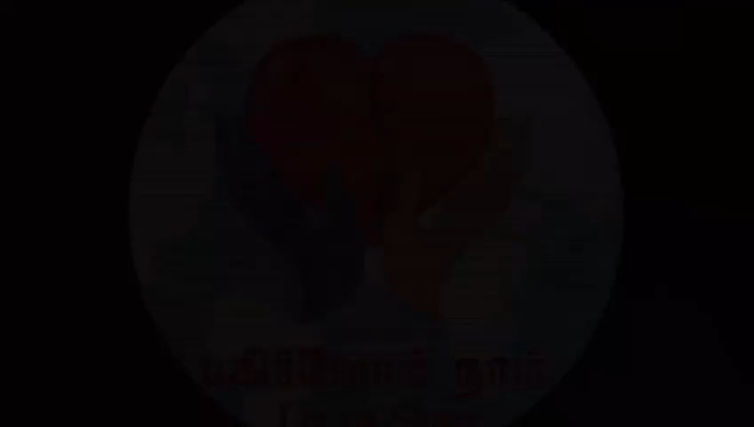
Food sharing program. 3.38 minutes video

Slide 10
Our general chapter(2021) summarises the LS:
Dream:
We dream of a Congregation committed to universal fraternity (Brothers All), justice, peace and care for the common house (LS).
By the year 2027, respect for and protection of the integrity of creation must have substantially transformed our way of life. We must recognise and contemplate the presence of the Trinity in all creation. We must care for our sister Mother Earth and denounce all destructive exploitation.
Commitment:
To achieve these goals, we must commit ourselves to:
Inculcate the objectives of Laudato Si' in initial and ongoing formation, in apostolic works.

Slide 11
Living a simple and ecological life in our personal lives and in our communities.
Raise our prophetic voice to denounce all that threatens life.
Prioritise our pastoral attention to the most vulnerable groups.
Work with those who seek the transformation of the world.
Reflection:
To walk with the Church and the Congregation, we need to design an action plan on Laudato Si' for our personal and community life.

Slide 12
What we did:
The Claretian Family wanted to live the objectives of the LS. Therefore a study was conducted to find out what ecological practices are already being done and what more can be done. In this survey 478 members of the Claretian Family from 56 countries participated.
What we want to do:
We will learn about the results of the survey.
We want to adopt this for our personal, community and apostolic lives

Slide 13
LSG 1. Cry of the earth:
We become Aware: of the challenges faced by the earth- climate change, pollution, acidification of the oceans, massive destruction of natural habitats.

Slide 14

Discernment as Catholic Religious
( It is the discernment in the light of the teachings of the Bible and Social teachings of the church that differentiates us from other NGOs)
We know that the whole creation has been groaning as in the pains of childbirth right up to the present time (Romans 8,22)
The earth mourns and withers; the world languishes and withers; the highest people of the earth languish. The earth lies defiled under its inhabitants; for they have transgressed the laws, violated the statutes, broken the everlasting covenant (Isiah 24: 4-5)
The earth, our home, is beginning to look more and more like an immense pile of filth. In many parts of the planet, the elderly lament that once beautiful landscapes are now covered with rubbish (LS 21)
There is an urgent need to develop policies so that, in the next few years, the emission of carbon dioxide and other highly polluting gases can be drastically reduced, for example, substituting for fossil fuels and developing sources of renewable energy (LS 26)

Slide 15
Commitment
Promote organic- agriculture, aquaculture, animal husbandry, native birds and animals
Celebrate Ecological week in the communities/apostolates.
Oppose the polluting projects, extractive companies, land grabbing, agri-business.
Promote planting of trees, native plants and seeds
Promote renewable energy.
Defend water as a common good
Promote care for lakes, rivers and oceans.

Slide 16
LSG 2. Cry of the poor:
We become Aware:
Of the impacts of the environmental destruction are suffered by the vulnerable people.

Slide 17
Discernment as Catholic Religious
When you reap the harvest of your land, do not reap to the very edges of your field or gather the gleanings of your harvest. Do not go over your vineyard a second time or pick up the grapes that have fallen. Leave them for the poor and the foreigner. I am the Lord your God (Leviticus 19, 9-10)
They caused the cry of the poor to come before him, so that he heard the cry of the needy (Job 34,28)
Both everyday experience and scientific research show that the gravest effects of all attacks on the environment are suffered by the poorest (LS 48)
Generally speaking, there is little clear awareness of problems which especially affect the excluded people. Yet they are the majority of the planet’s population, billions of people (LS 49)

Slide 18

Commitment
Promote education among the poor, the women and LGBT communities
Create livelihood for the marginalized people and communities
Share the facilities of the community with the poor
Work against corruption which is a principal cause of poverty

Slide 19
LSG 3 Ecological Economics:
We become Aware:
That the production and consumption of goods/food need to be without destruction of the environment.

Slide 20
Discernment as Catholic Religious
And the Lord God commanded the man, saying, you may surely eat of every tree of the garden, but of the tree of the knowledge of good and evil you shall not eat, for in the day that you eat of it you shall surely die (Genesis 2, 16-17)
The land must not be sold permanently, because the land is mine and you reside in my land as foreigners and strangers (Leviticus 25, 23)
We have not yet managed to adopt a circular model of production capable of preserving resources for present and future generations, while limiting as much as possible the use of non-renewable resources, moderating their consumption, maximizing their efficient use, reusing and recycling them (LS 22)
The principle of the maximization of profits, frequently isolated from other considerations, reflects a misunderstanding of the very concept of the economy (LS 195)

Slide 21
Commitment
Purchasing locally produced goods from local- small market
Purchase fair- trade goods
Foster awareness on the economy of Francesco
Promote green-sustainable constructions of houses and churches
Promote ethical investments
Use as well as create market for second hand goods

Slide 22
LSG 4. Sustainable lifestyle:
We become Aware:
of the fact that our personal life need to be marked by less possession of goods, less carbon emission and absence of conspicuous consumerism.

Slide 23
Discernment as Catholic Religious
A pretentious, showy life is an empty life; a plain and simple life is a full life (Proverbs 13,7)
I have learned the secret of being content in any and every situation, whether well fed or hungry, whether living in plenty or in want (Philip 4,12)
Since the market tends to promote extreme consumerism to sell its products, people can easily get caught up in a whirlwind of needless buying and spending (LS 203)
There is a nobility in the duty to care for creation through little daily actions…. such as avoiding the use of plastic and paper, reducing water consumption, separating refuse, cooking only what can reasonably be consumed, showing care for other living beings, using public transport or car-pooling, planting trees, turning off unnecessary lights (LS 211)

Slide 24
Commitment
Not to waste food and not to smoke in the family/house
Economic use of water, energy, plastic, paper, cosmetics and body sprays
Separate collection and disposal of the domestic waste
Use public transport as much as possible
Follow more alternative methods for health and plant based diet
Observe media fasting day on certain days

Slide 25
LSG 5. Ecological education:
We become Aware: of the need to be in the process of continuous learning about the environment.

Slide 26
Discernment as Catholic Religious
I will send you the seasonal rains. The land will then yield its crops, and the trees of the field will produce their fruit (Leviticus 26, 4)
The heavens proclaim the glory of God. The skies display his craftsmanship. They speak without a sound or word. Yet their message has gone throughout the earth, and their words to all the world (Psalm 19,1-4)
Environmental education has broadened its goals. Whereas in the beginning it was mainly centred on scientific information, consciousness-raising and the prevention of environmental risks, it tends now to include a critique of the “myths” of a modernity grounded in a utilitarian mindset-individualism, unlimited progress, competition, consumerism, the unregulated market (LS 210)
It is my hope that our seminaries and houses of formation will provide an education in responsible simplicity of life, in grateful contemplation of God’s world, and in concern for the needs of the poor and the protection of the environment (LS 214)

Slide 27
Commitment
Learning the impact of environmental destruction on the poor and the indigenous
Studying the Bible and the teachings of the Church, with ecological eyes
Including ecological subjects in catechism, schools, universities and seminaries
Studying about the environmental laws /treaties of the country and the UN

Slide 28
LSG 6. Ecological spirituality:
We become Aware:
that there is spiritual connection between human beings and the planet earth

Slide 29
Discernment as Catholic Religious
The earth was formless and void, and darkness was over the surface of the deep, and the Spirit of God was moving over the surface of the waters (Genesis 1,2)
Where can I go from Your Spirit?, Or where can I flee from Your presence? (Ps 139,7)
The life of the spirit is not dissociated from the body or from nature or from worldly realities, but lived in and with them, in communion with all that surrounds us (LS 216)
Each creature reflects something of God and has a message to convey to us…there is the recognition that God created the world, writing into it an order and a dynamism that human beings have no right to ignore (LS 221)

Slide 30
Commitment
Learning and practicing contemplative prayer/meditation (yoga, vipassana)
Preparing liturgical materials, songs and eco calendar to promote eco spirituality
Not to use plastic goods, tree branches and genetically modified plants in the chapels
To consider the acts against environmental as sin

Slide 31
LSG 7. Community involvement in Advocacy and Campaign:
We become Aware:
That actions have to be planned and executed in network to promote integral ecology.

Slide 32
Discernment as Catholic Religious
For where two or three are gathered in my name, there am I among them (Mt 18, 20)
If one member suffers, all suffer together; if one member is honoured, all rejoice together (1 Cor 12, 26)
The climate is a common good, belonging to all and meant for all (LS 23)
A global consensus is essential for confronting the deeper problems, which cannot be resolved by unilateral actions on the part of individual countries (LS 164)

Slide 33
Commitment
To continue the advocacy for the migrants, indigenous people
To continue the advocacy for the defense of life and gender justice
To continue the advocacy against State corruption
To continue the advocacy against the extractive companies
To join the advocacy for the defence of the threatened environmental leaders
To join the advocacy for the recognition of Climate Migrants
To join advocacy for family wage

Slide 34
We need to make a plans on these proposals at the levels of :
Personal
Community life
Apostolate of the community

Slide 36

Words of Greetings:
We pray that these seeds be planted and bear fruit in our life and mission.
Living in communion with all forms of life is no more an option but has become an obligation.

